Slide 1
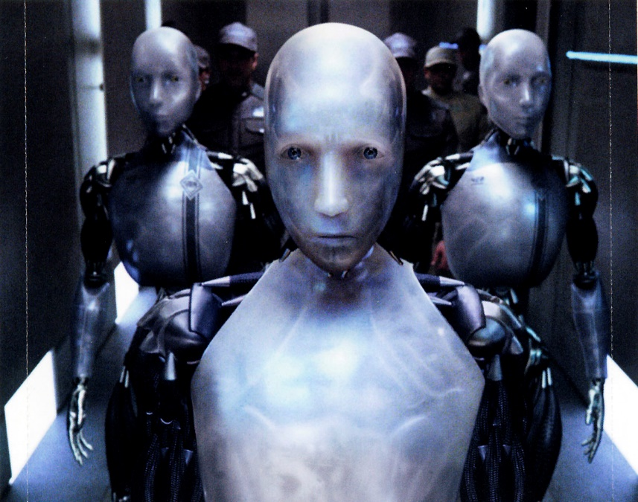
Impact of Robots on Humans
何珮萁 405086041 張雪兒 405084020
吳雨霏 405084046 陳韻琳 405081026
林沛萱 405081182 張雋揚 405081042

Slide 2
Summary
1. Security problems that robots may caused
2. Impact on jobs and economy

Slide 3
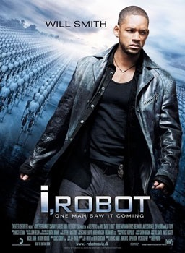
science fiction film
i,robot

Slide 4
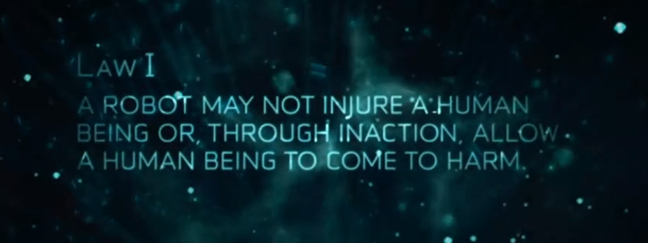
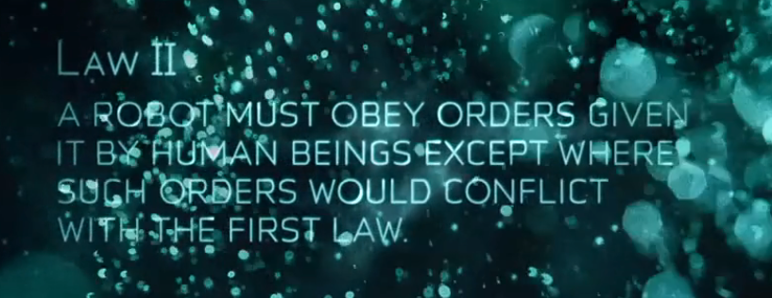
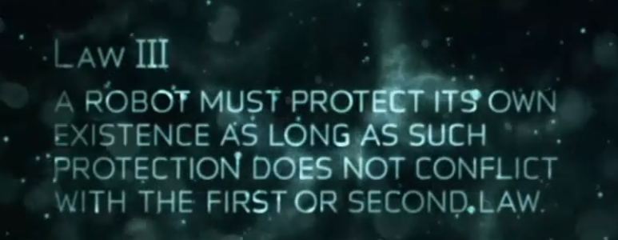
Isaac Asimov
Three Laws of Robotics

Slide 5
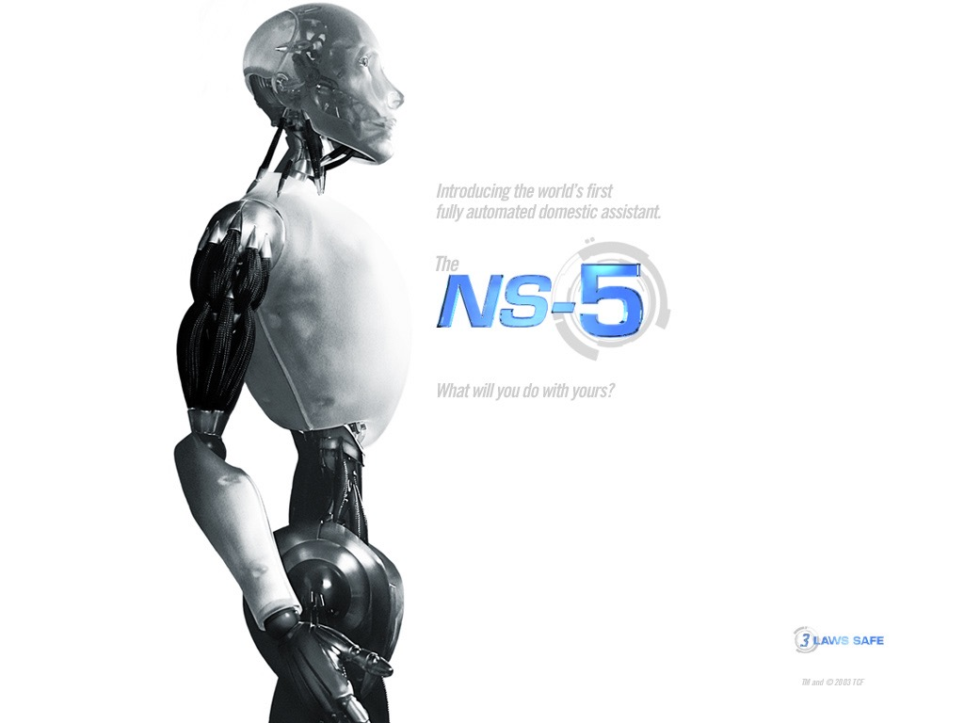
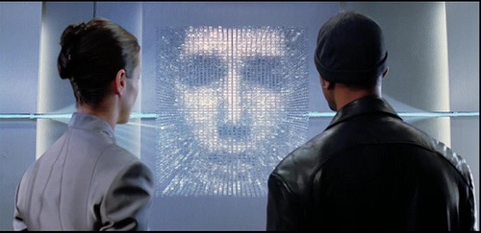
Sonny
Viki

Slide 6
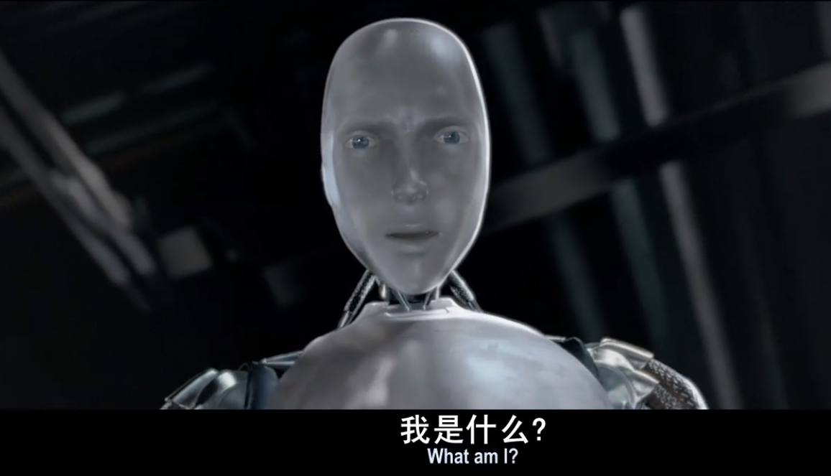
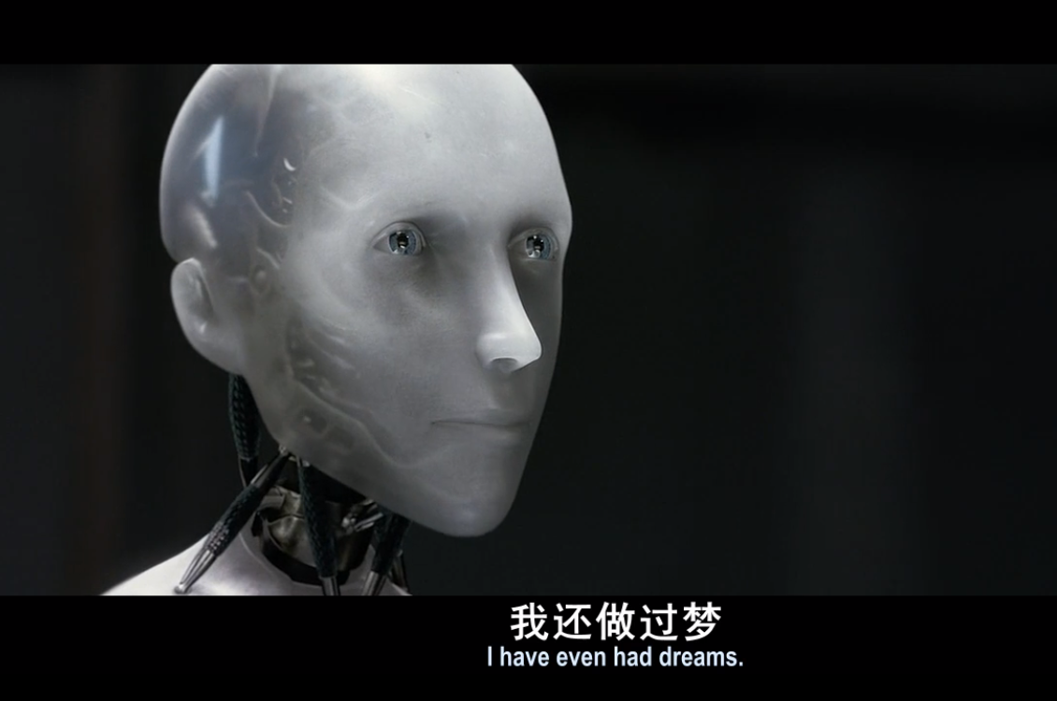
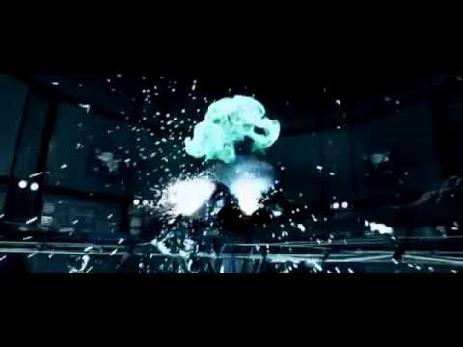
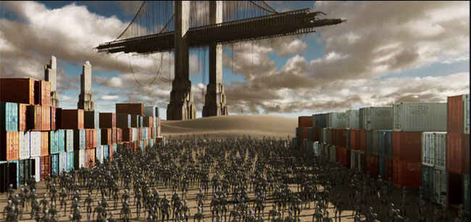

Slide 7
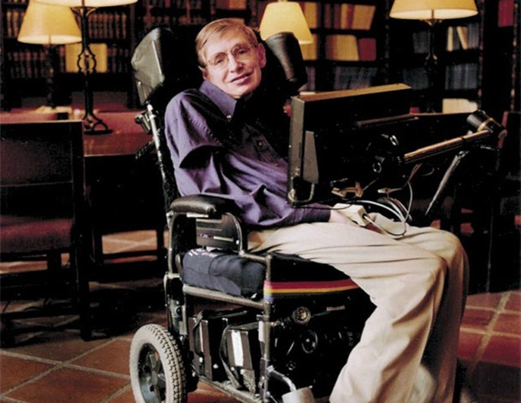
Stephen Hawking
Artificial intelligence

Slide 8
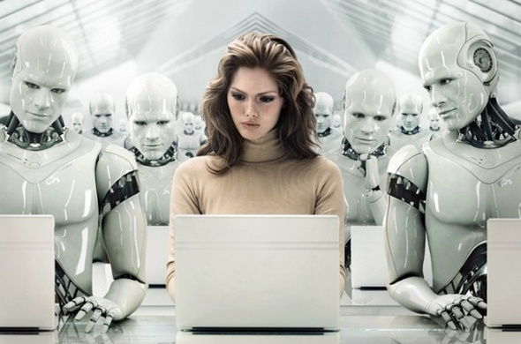
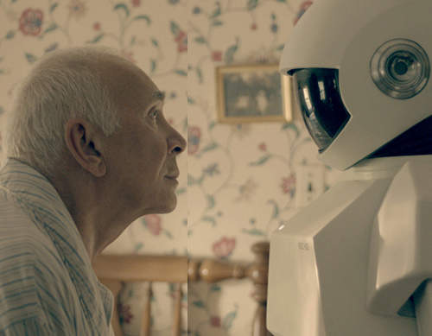
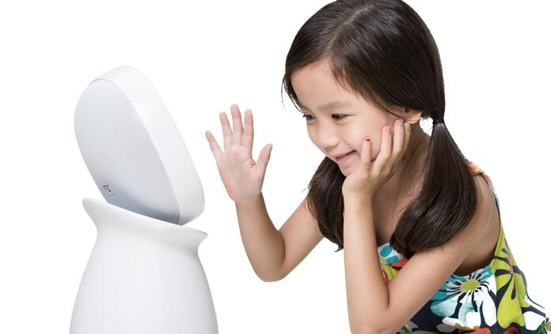
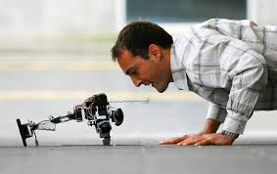
robot
human

Slide 9
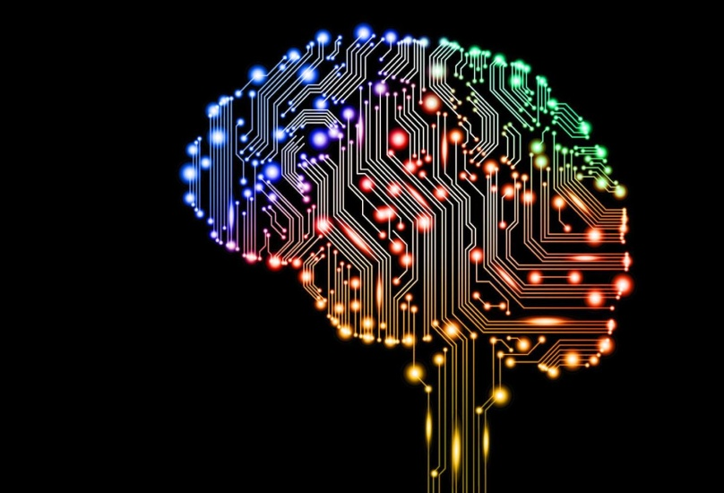

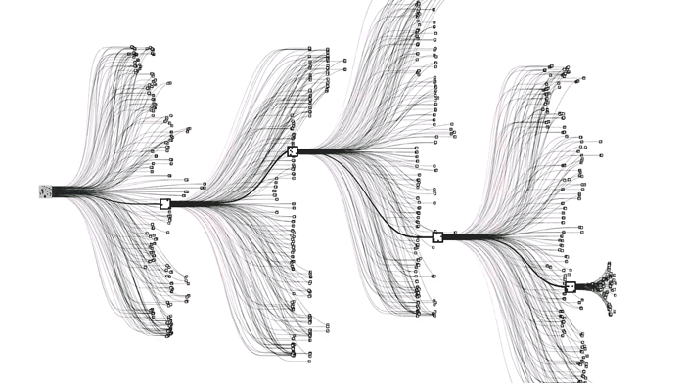
Intelligence

Slide 10
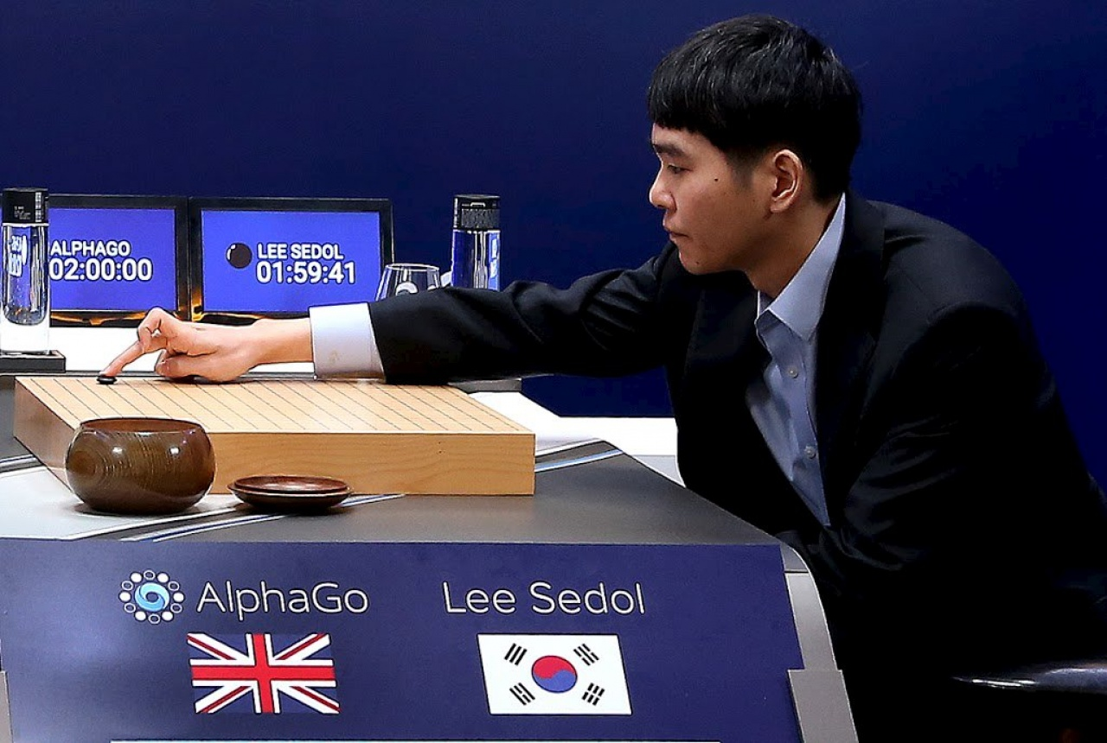
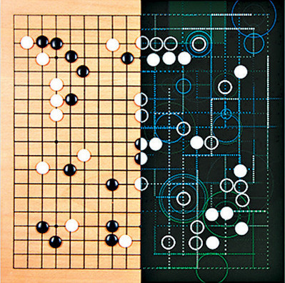
AlphaGo VS Lee

Slide 11
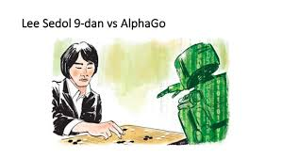
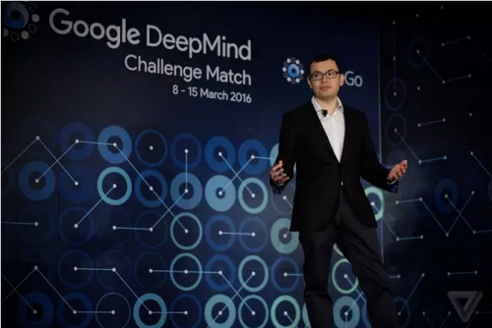
4:1
deliberately lost?

Slide 12
Develop human talents
Balance ourselves and robots
Overpower???

Slide 13

Watch out !
Danger
was coming!!

Slide 14
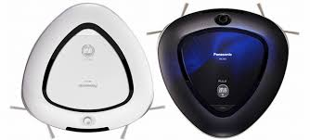
Cleaning
Robots

Slide 15
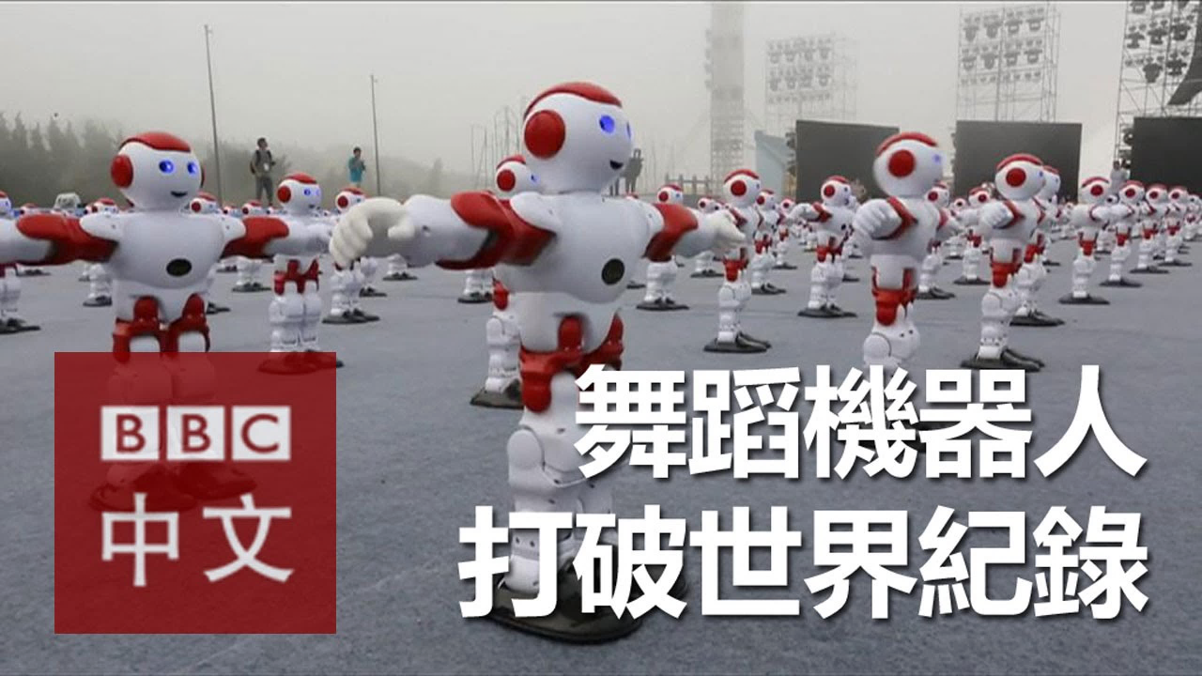

Slide 16
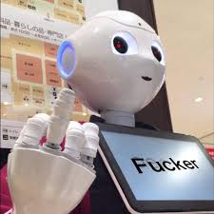

Slide 17
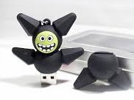

Slide 18
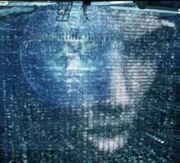
Social security

Slide 19


Ok….Perhaps you would say….

Slide 20
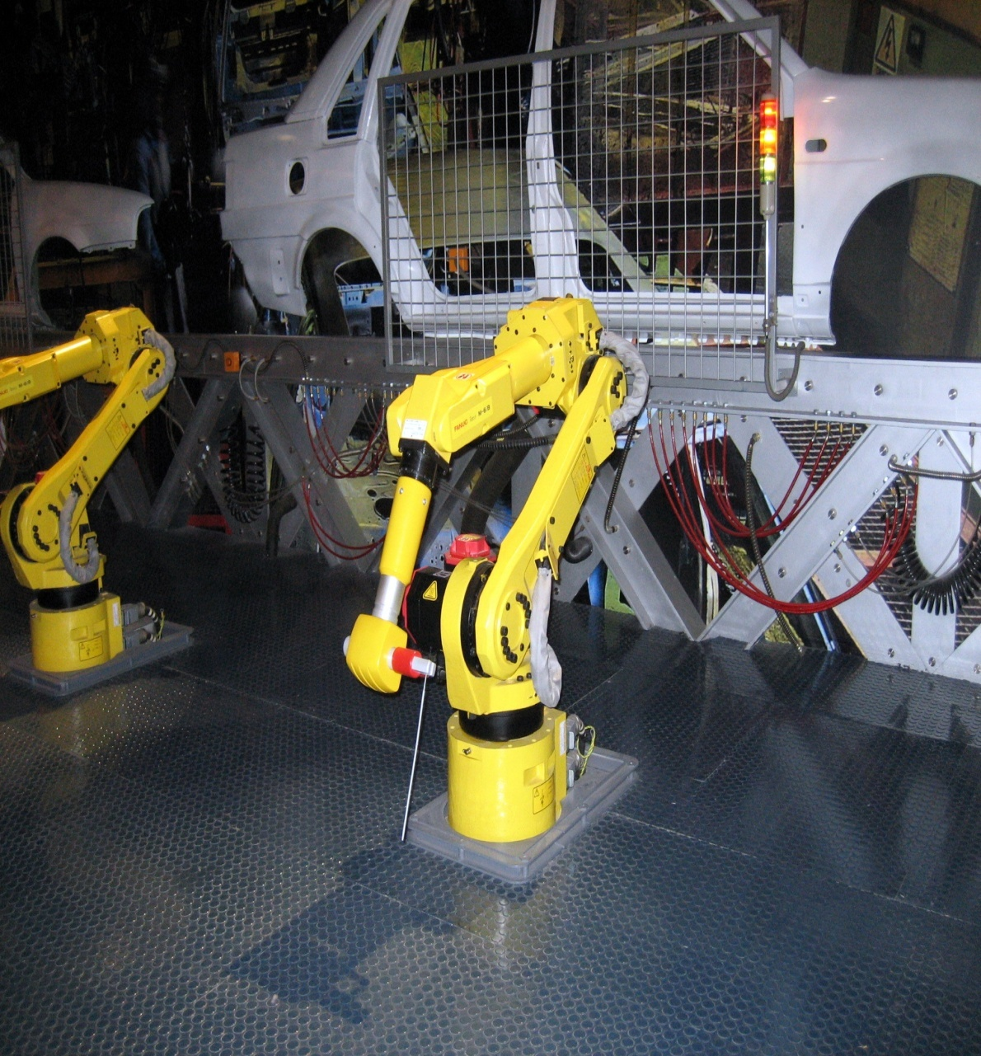
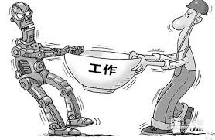
Take away the job

Slide 21
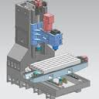
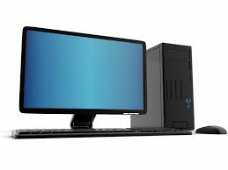
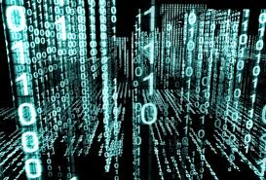

Slide 22
In the past
1.only parts of industry be affected
2.change slowly
3.labors could change their career
Nowadays
1.all of industry be affected
2.rapidly change
3.a large number of unemployed people

Slide 23
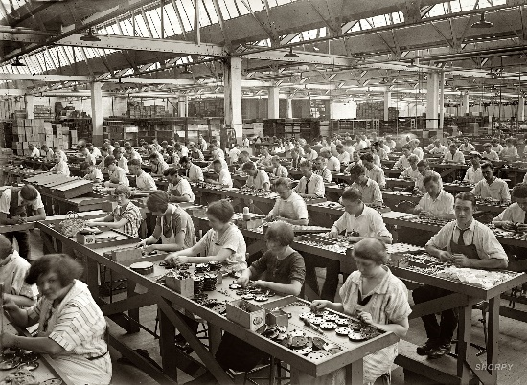
Factory workers

Slide 24


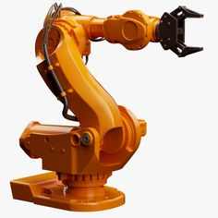

24 hours
8 hours
Rest
Rest
v.s.
Robot
Human worker

Slide 25
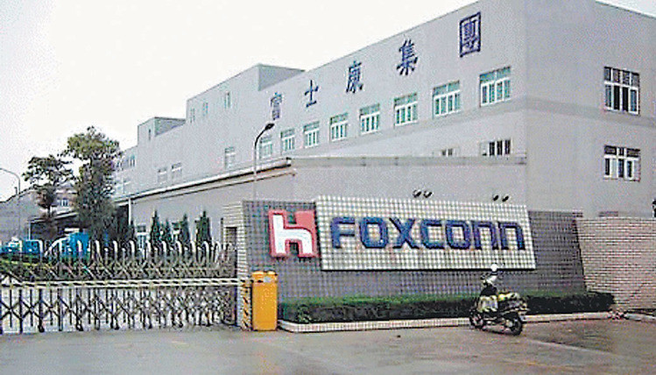
Foxconn

Slide 26
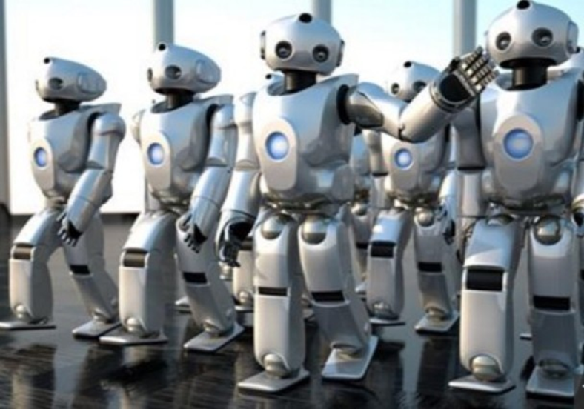
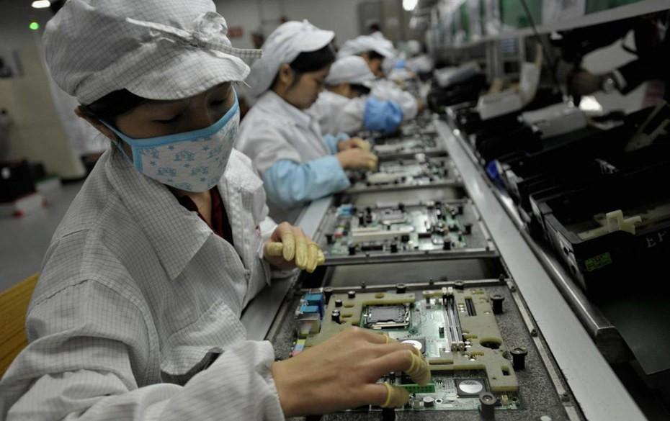

Slide 27
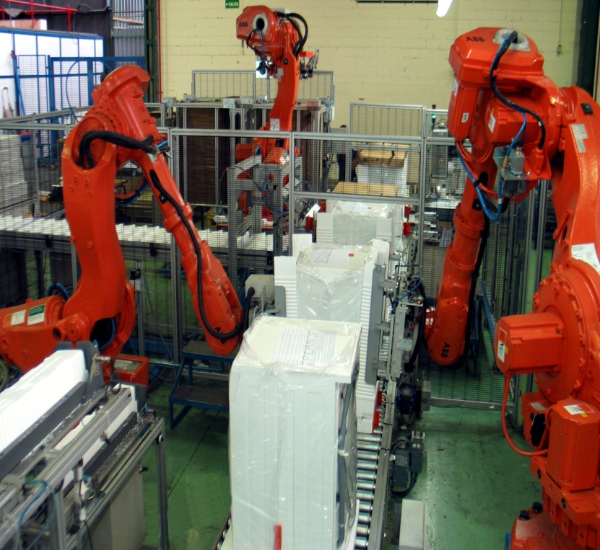
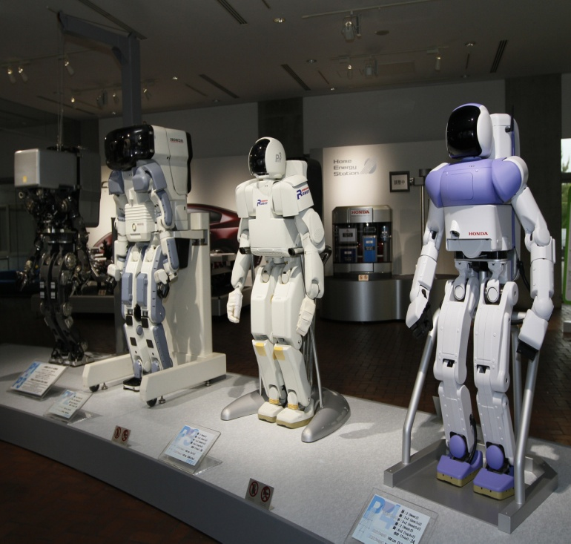
JOB KILLERS?
Job Creators?

Slide 28
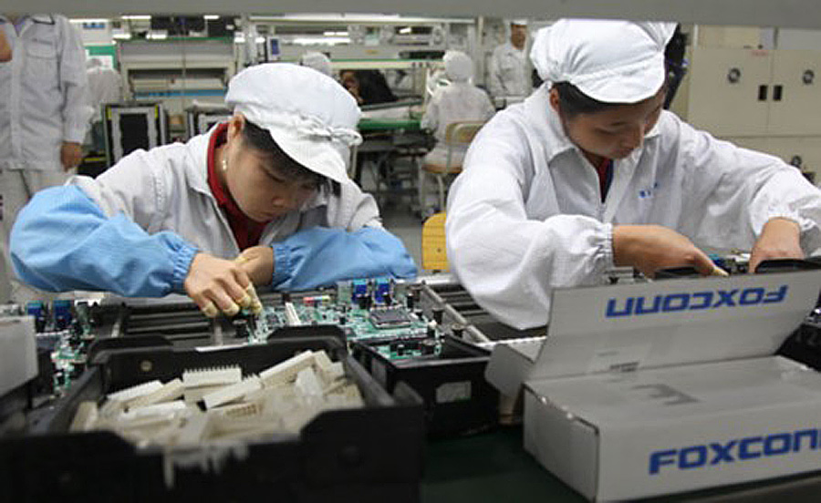
3D
Dirty
Dull
Dangerous

Slide 29
Benefits Bring by Robots
works in areas that would be unsafe for humans
works that would not be economically viable
works that would be impossible for humans
Solve social issue

Slide 30
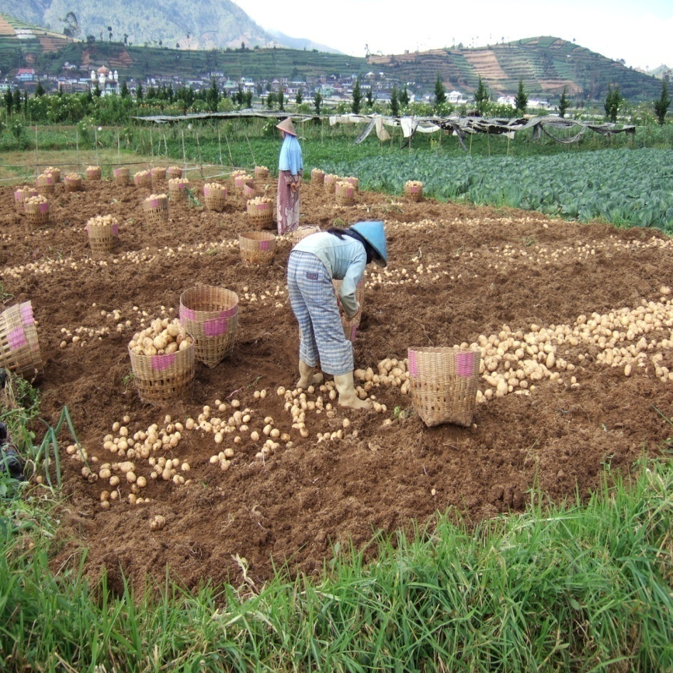

Our Ancestors
Us

Slide 31
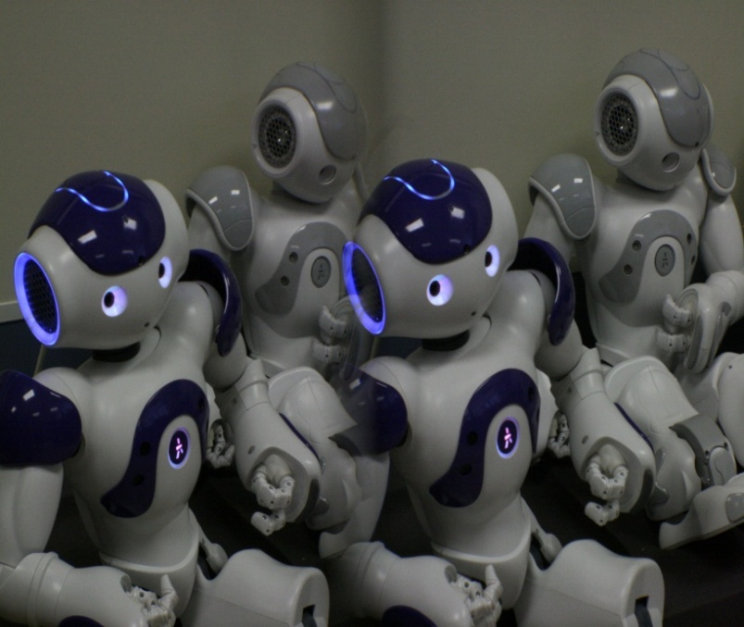
Jobs Create by Robots
To design robots
To build robots
To fix robots
To update the data of
robots

Slide 32
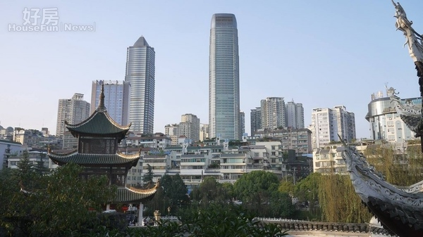
Good Economy

Slide 33
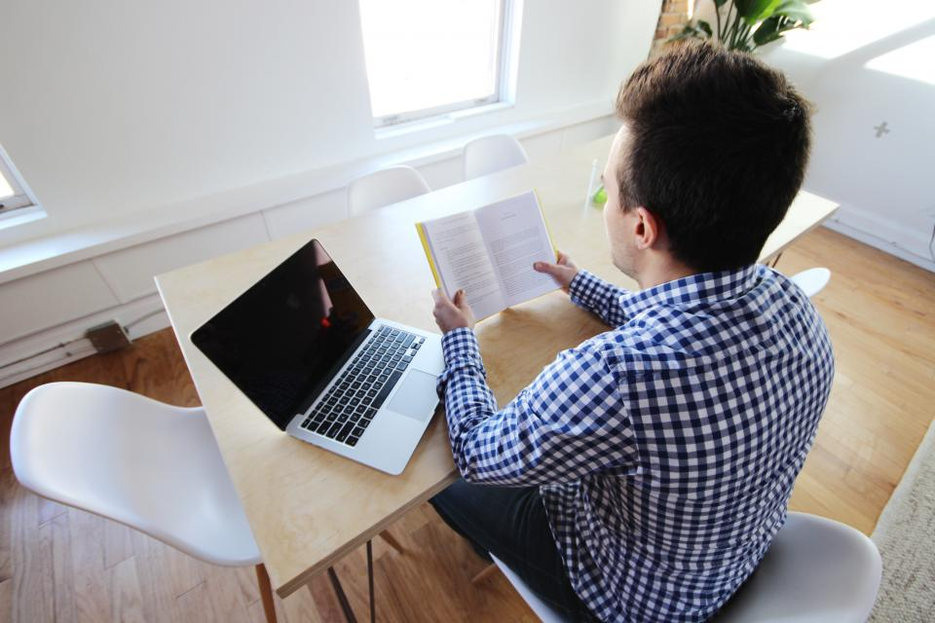
Created Job

Slide 34

More Competitive

Slide 35
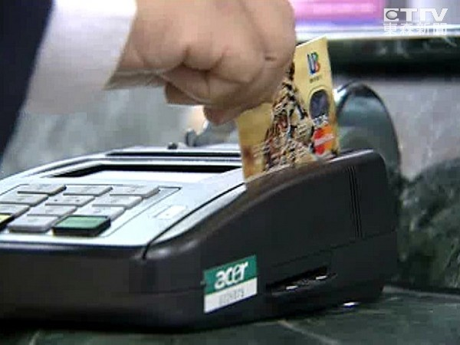
High consuming power

Slide 36
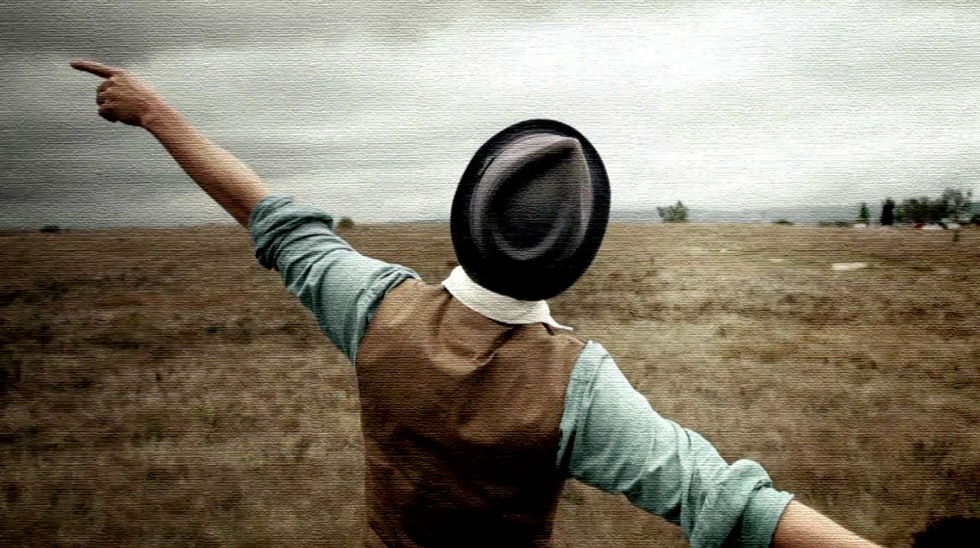
Good Life

Slide 37
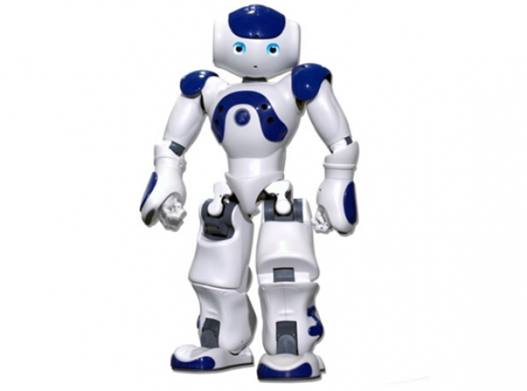
Indispensable

Slide 38
Thank you for your listening

