Slide 1

Global Technology Revolution
Members: 400820089 周思妤 Stephanie
400820329 林珮瑜 Irene
400820501 曾瑞筑 Sally
400826516 潘喜臨 Lynn

Slide 2

history
2006/08 7-ELEVEN provide「ibon」system
The goal
-ibon is the service center which closes the
consumer very much.
-ibon is a platform that has an interaction
between the provider and consumers.

Slide 3
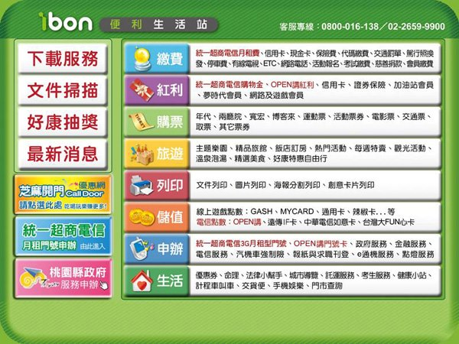
Function

Slide 4
Function– print&scan
The picture and file printing
The poster printing
special cards printing
The file uploading
The customization
The example

Slide 5
Function-- ticket
The exhibition
The system of ticket selling(type)
The example

Slide 6
Function-- travel
The theme park
The hotel booking
The example

Slide 7
Function– digital life
Jobs
Service for student
The taxi
I cat
Laundry
Address of Branches
The example

Slide 8
Function-- download
The file downloading
The application form
Life information
Pictures
Policy guidance
The example

Slide 9
Function-- recharge
Online game
Virtual treasure
Telecommunication recharging
International phone call
The example

Slide 10
Function-- dividend
icash、 icash Easy Card
telecommunication company
credit card
Gas station
Online game
Deparment store
security & insurance
The example

Slide 11
Function– pay out
Telecommunication recharging
Public affairs
Code
Financial service
Charitable donation
Foreign labor
Telecommunication & television
The example

Slide 12
Function– bid for service
7 mobile telecommunication application
loan application
Government application
The insurance service
Other application
The example

Slide 13
Function– coupon
The lucky draw
voucher
The example

Slide 14
Advantage
disadvantage

Slide 15
Thanks for listening

