Slide 2
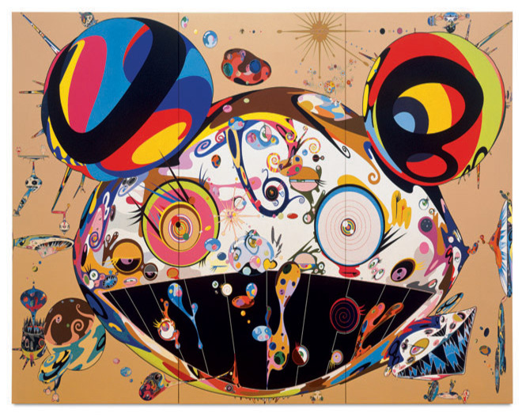
ART Challenge
START

